Slide 1
BERT-Based Emotion Recognition:
A Comprehensive Study in Dari Texts
Group Number: 02
RA: Ehsanur Rahman Rhythm
ST: Mehnaz Ara Fazal
241057 Malika Muradi
21141064 Basit Hussain

Slide 2
Introduction:
Low resource language with over 110 million speaker around the world
Importance of Dari language in Businesses
Literature review:
EmoPars and ArmanEmo two human labeled dataset,
F1-score 0.76 and o.81
Compare Pars BERT and Multilingual BERT
Performance evaluated in NLP tasks
Pars BERT better performance

Slide 3
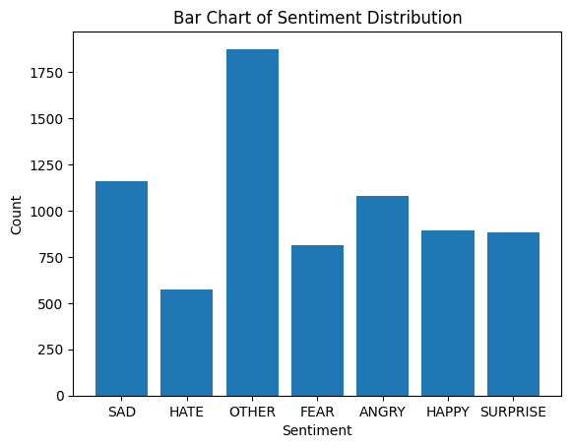
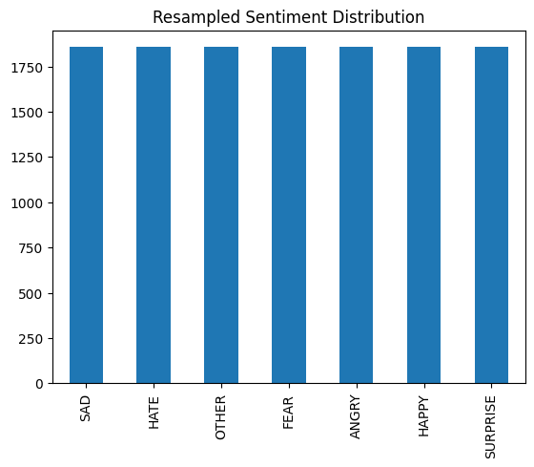
Dataset
Data collection:
ArmanEmo
Comprehensive manually labeled emotion dataset
7,000+ Dari Sentences
Categorized into 7 Emotion Classes (Anger, Fear, Happiness, Hatred, Sadness, Wonder, Other)
Source of comments from (Twitter, Instagram, Digikala (Iranian e-commerce platform))
B. Data Augmentation:
Random Oversampling Technique
Fig 1: Sentiment Distribution before Augmentation
Fig 1: Sentiment Distribution after Augmentation

Slide 4
Dataset (Con…)
C. Data Preprocessing:
Data Cleaning
Tokenization Techniques (ParsBERT Tokenizer and Multilingual BERT Tokenizer)
Mapping Tokens to Word IDs
Representative Split for Training and Testing 85% for Training Data 15% for Testing Data

Slide 5
Methodology
ParsBERT Model:
. Overview
Utilization: Pre-trained Pars-BERT model
Domain: Emotion detection within Dari text
Foundation: Based on Google BERT architecture
Pre-training Data:
Extensive Persian corpora
Diverse writing styles (scientific, literary, journalistic)
Statistics:
3.9 million documents
73 million sentences
Lexical repository of 1.3 billion words

Slide 6
Methodology (Con…)
Model Architecture
Embedding Layer:
Maps input tokens to vectors
Transformer Blocks:
12 bidirectional blocks
Multi-head self-attention mechanism
Fully connected feed-forward network
Training Details:
Batch size: 16
Learning rate: 2e-5
Training epochs: 4
Evaluation and Interpretability
Evaluation Process
LIME XAI Method

Slide 7
Methodology (Con…)
B. Multilingual BERT Model:
Comparative analysis:
Utilization: BERT-base-multilingual-cased variant
Task: Emotion detection in Dari text
Training Details:
Batch size: 16
Training epochs: 4
Fine-tuning:
Dari text dataset with input IDs, token type IDs, attention masks, and emotion labels
Iterative Process:
Dynamic adjustment of internal parameters
Refinement of ability to discern and classify emotions

Slide 8
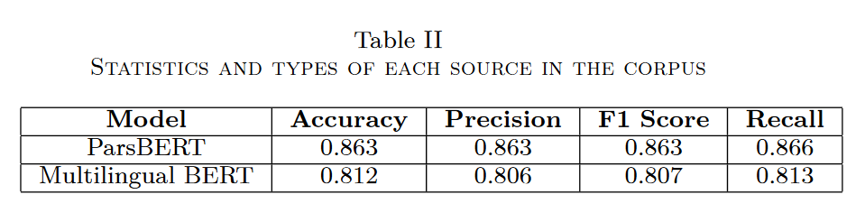
Results and Discussion

Slide 9
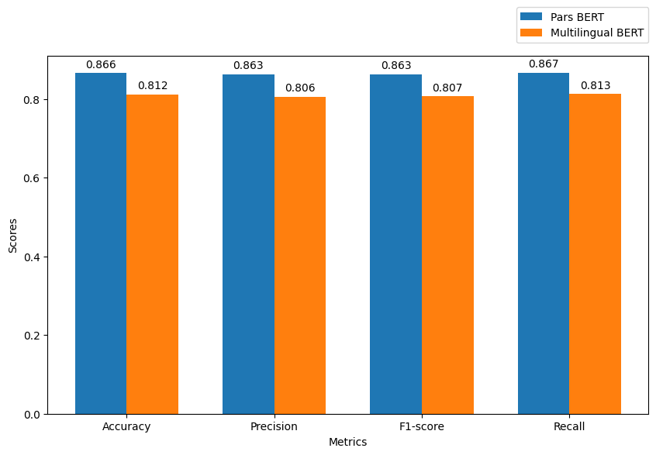
Results and Discussion (Con…)

Slide 10
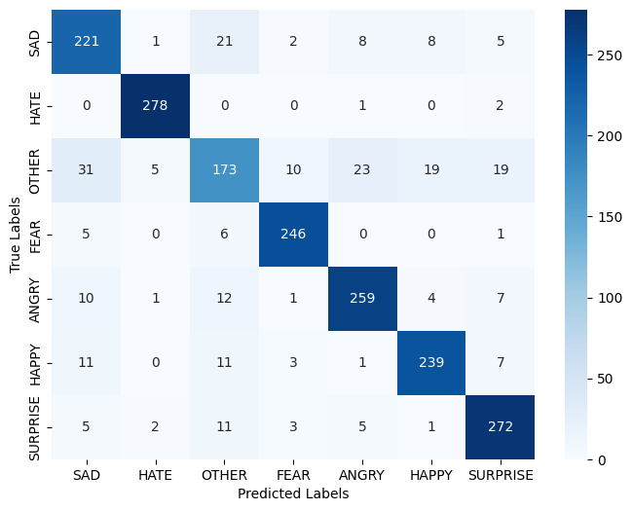
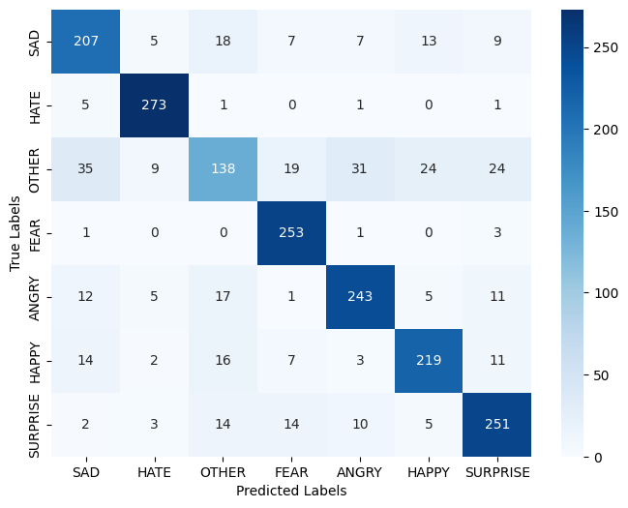
Results and Discussion (Con…)
Fig 1: Confusion Metric for ParsBERT Model
Fig 2: Confusion Metric for Multilingual BERT Model

Slide 11
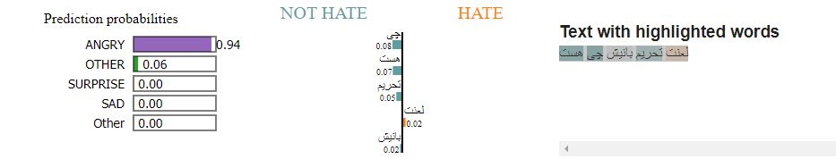
Implementation Of Explainable AI
Explainable AI for Pars BERT model

Slide 12
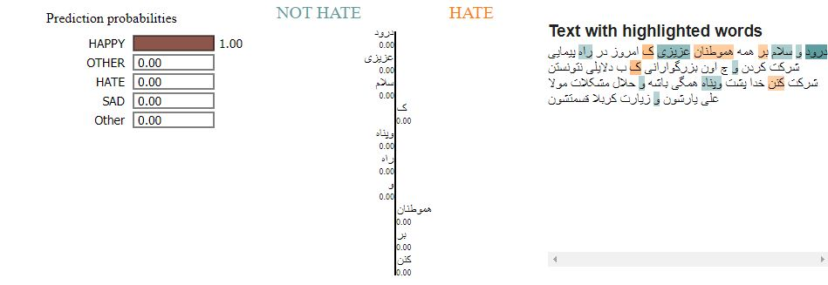
Greetings and salutations to all my dear compatriots who participated in the march today and to those honorable people who could not participate for some reason, may God protect them all and solve the problems of Mullah Ali Yaar and their pilgrimage to Karbala.

Slide 13
THANK YOU

